Slide 1
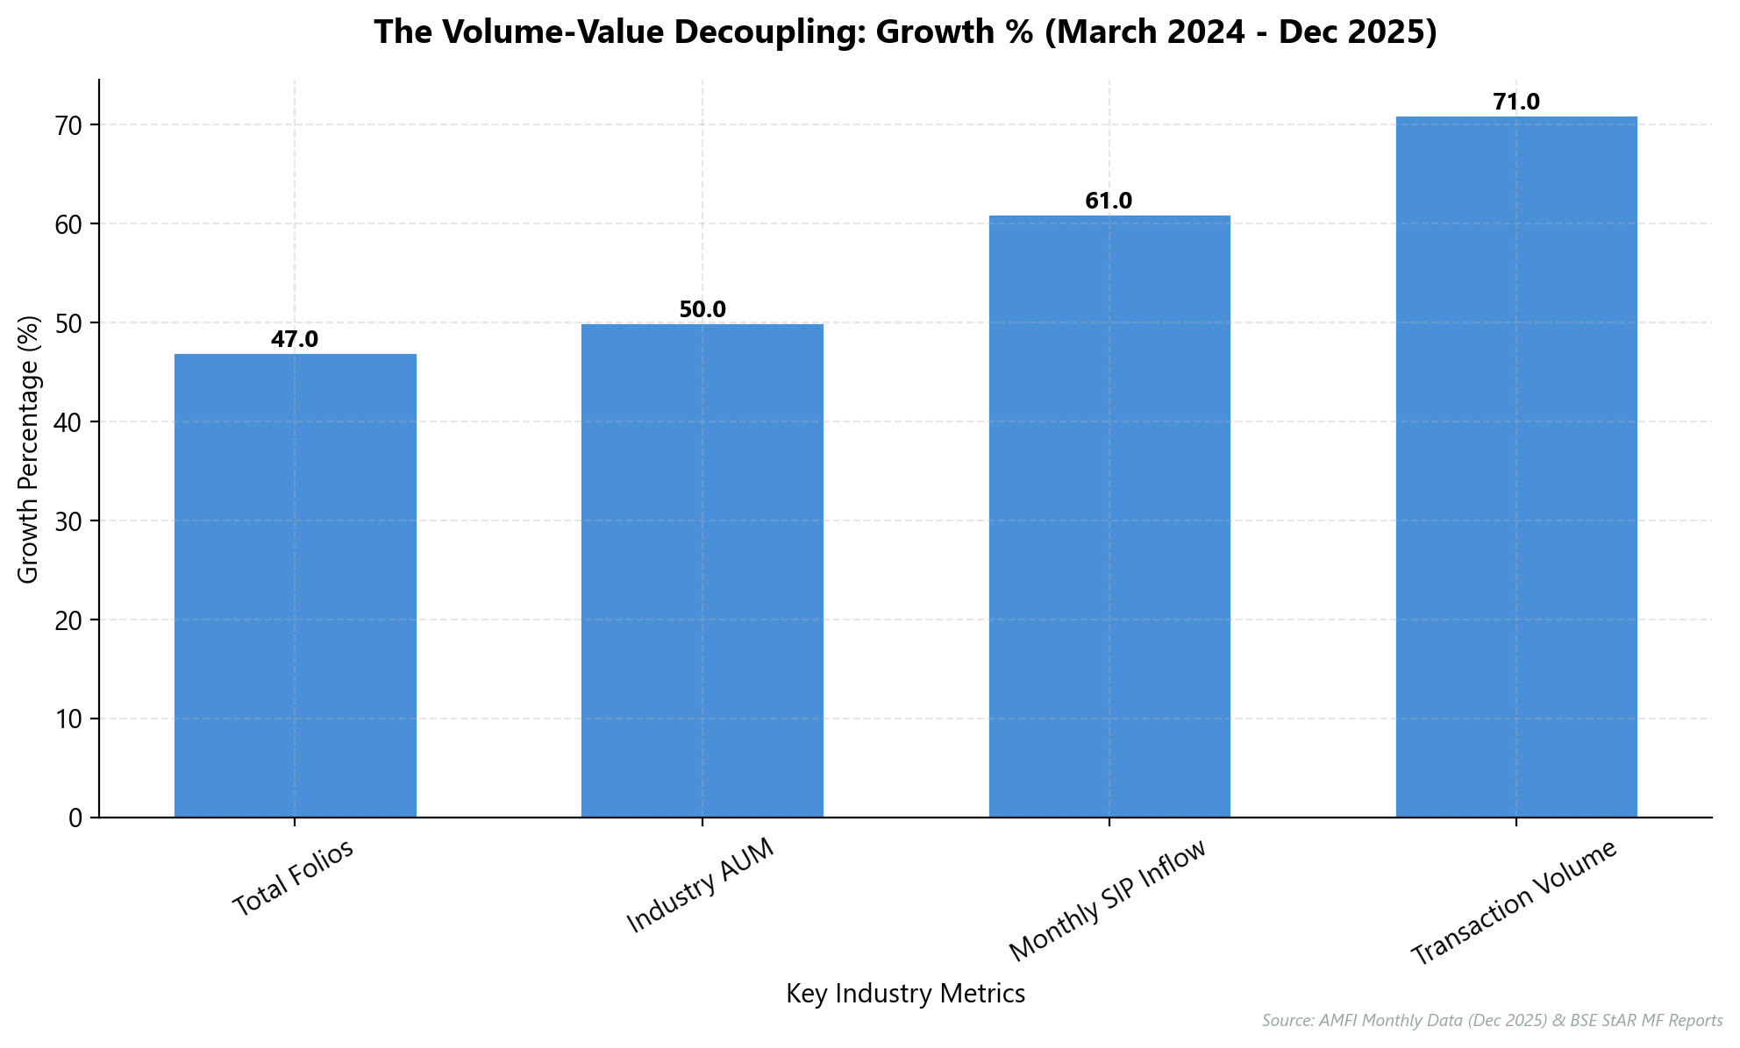
Pivot to Database-First: Scaling for ₹100 Trillion
Small-ticket SIPs (<₹500) grew 106% in FY25, outpacing high-value segments by 4x.
B30 cities drive 50% of new investors but average only ₹1.13 Lakh ticket size.
Transaction velocity surged to 663 million in FY25, creating massive operational bottlenecks.
Revenue parity with 2020 now requires processing 3x the volume due to margin compression.
70% of equity assets remain with MFDs, demanding automated segmentation to retain trust.
KEY INSIGHT: To survive the high-volume, low-ticket economy, MFDs must treat their database as their primary asset.
1

Slide 2
Automate Operations to Capture the 10x Volume Surge
Key Findings
Implement a centralized database immediately to manage exponential client volume.
Monthly SIP inflows surged 64% to ₹31,002 Cr in just 24 months.
Average ticket size dropped to ₹2,476, requiring high-volume automated processing.
Digital scaling delivers 40-50% efficiency gains, preparing for 100M investors.
Manual scaling is mathematically impossible with a 5x-10x volume increase; a database-first approach is the only viable path.
2

Slide 3
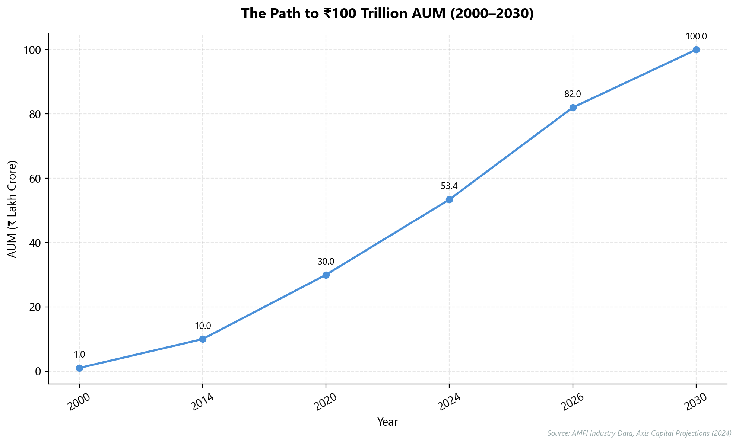
Riding the ₹100 Trillion Wave: A Deterministic Path
Industry AUM grew ~80-fold from ₹1.03 Lakh Cr (2000) to ₹82 Lakh Cr (2026).
Velocity accelerated: Added ₹28 Trillion in ~2 years versus 14 years for the first ₹10T.
Monthly SIP inflows hit record ₹31,002 Cr, providing a massive domestic liquidity cushion.
Digital adoption drove folio count to 26.63 Crore, with >50% new investors from B30 cities.
Conservative estimates project crossing ₹100 Trillion by 2030, ignoring aggressive ₹150T scenarios.
KEY INSIGHT: The industry has crossed a critical inflection point, putting the ₹100 Trillion target by 2030 on a deterministic path.
3

Slide 4
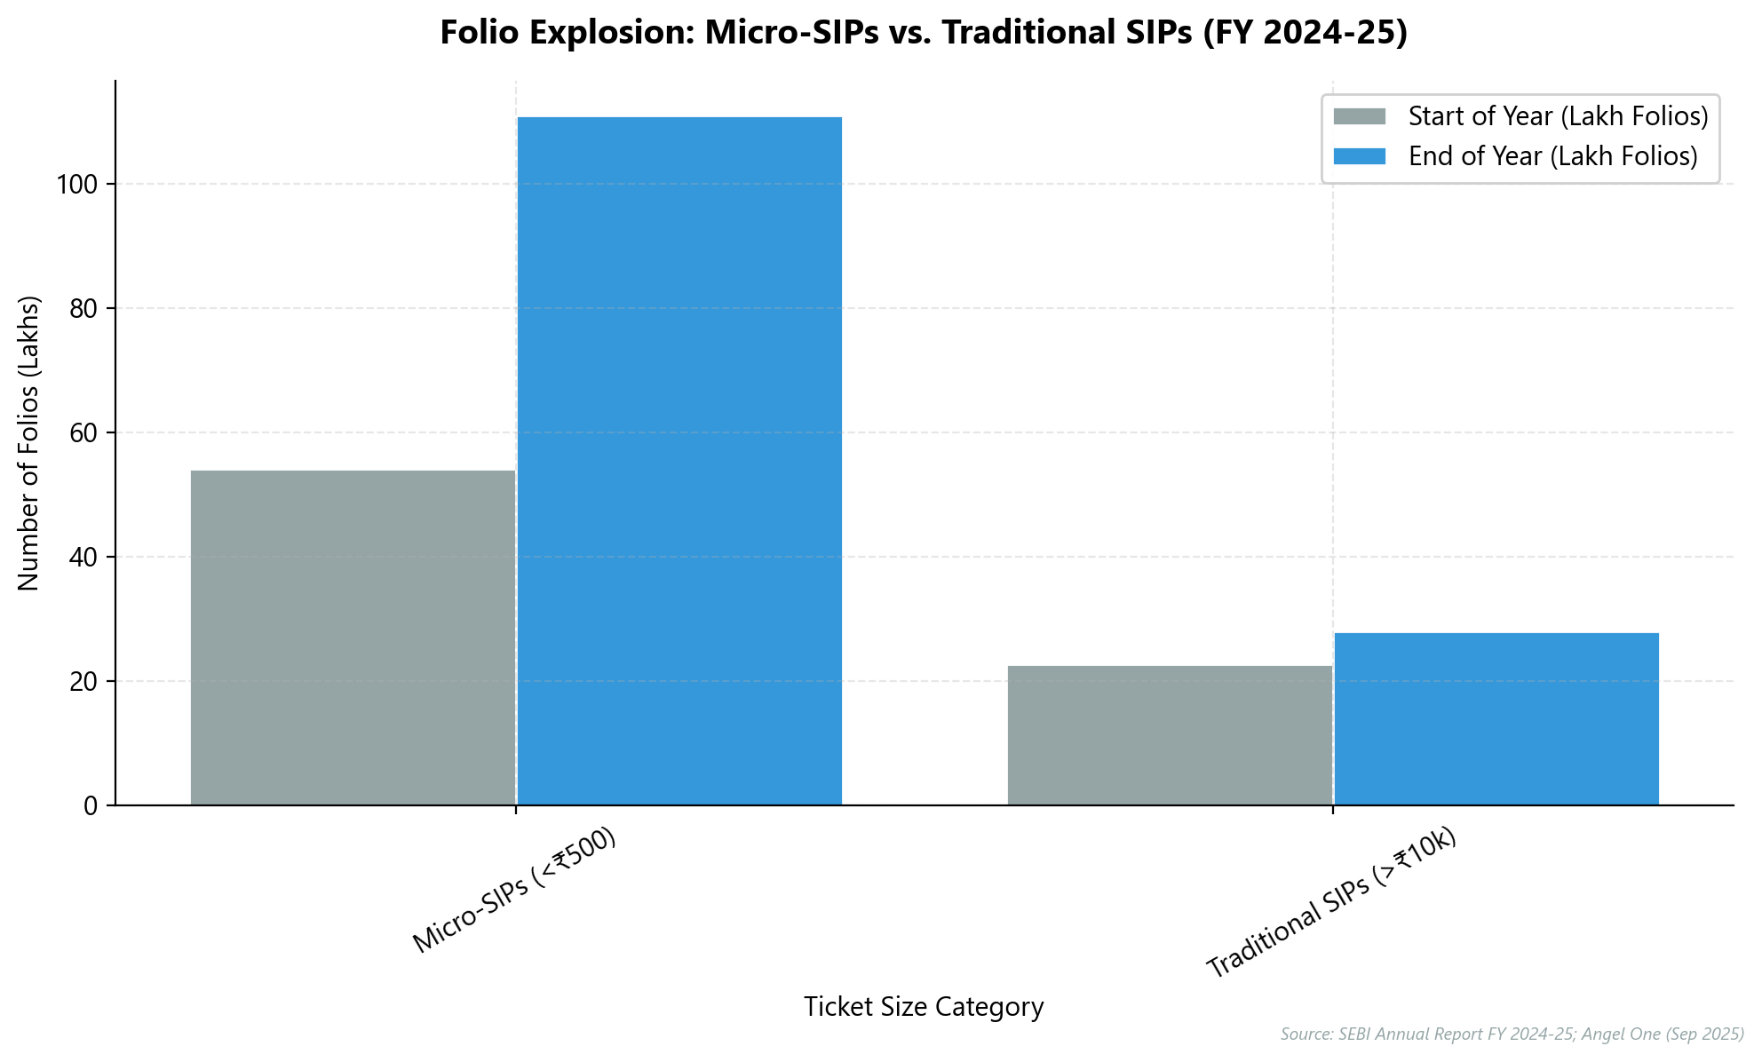
Profitability Now Hinges on High-Volume Micro-SIPs
Monthly SIP inflows doubled to ₹31,002 crore (Dec 2025) driven by volume.
Average ticket size stagnated at ~₹2,500, proving mass retail adoption.
Micro-SIPs (<₹500) surged 106%, while high-ticket SIPs grew only 24%.
Revenue model requires 10x client volume to match historical high-ticket value.
KEY INSIGHT: Profitability has decoupled from 'high net worth' and is now driven by 'high volume' SIPs.
4

Slide 5
Breaking Manual Bottlenecks to Unlock Exponential Scale
Operational Metric | Manual / Physical Model | Digital / Tech-First Model
Client Capacity per RM | ~150 Clients | 1,000+ Clients
Onboarding Time | 1-2 Business Days | < 10 Minutes
Geographic Reach | Hyper-Local (< 20 km) | Pan-India / B30
Cost of Acquisition (CAC) | ₹1,000 - ₹5,000 | ₹200 - ₹1,000
RM Productivity | 30% Client-Facing | 80%+ Client-Facing
Sources: Deloitte (2025), Backbase (2025), Bajaj Finserv / Star Global (2025)
5

Slide 6
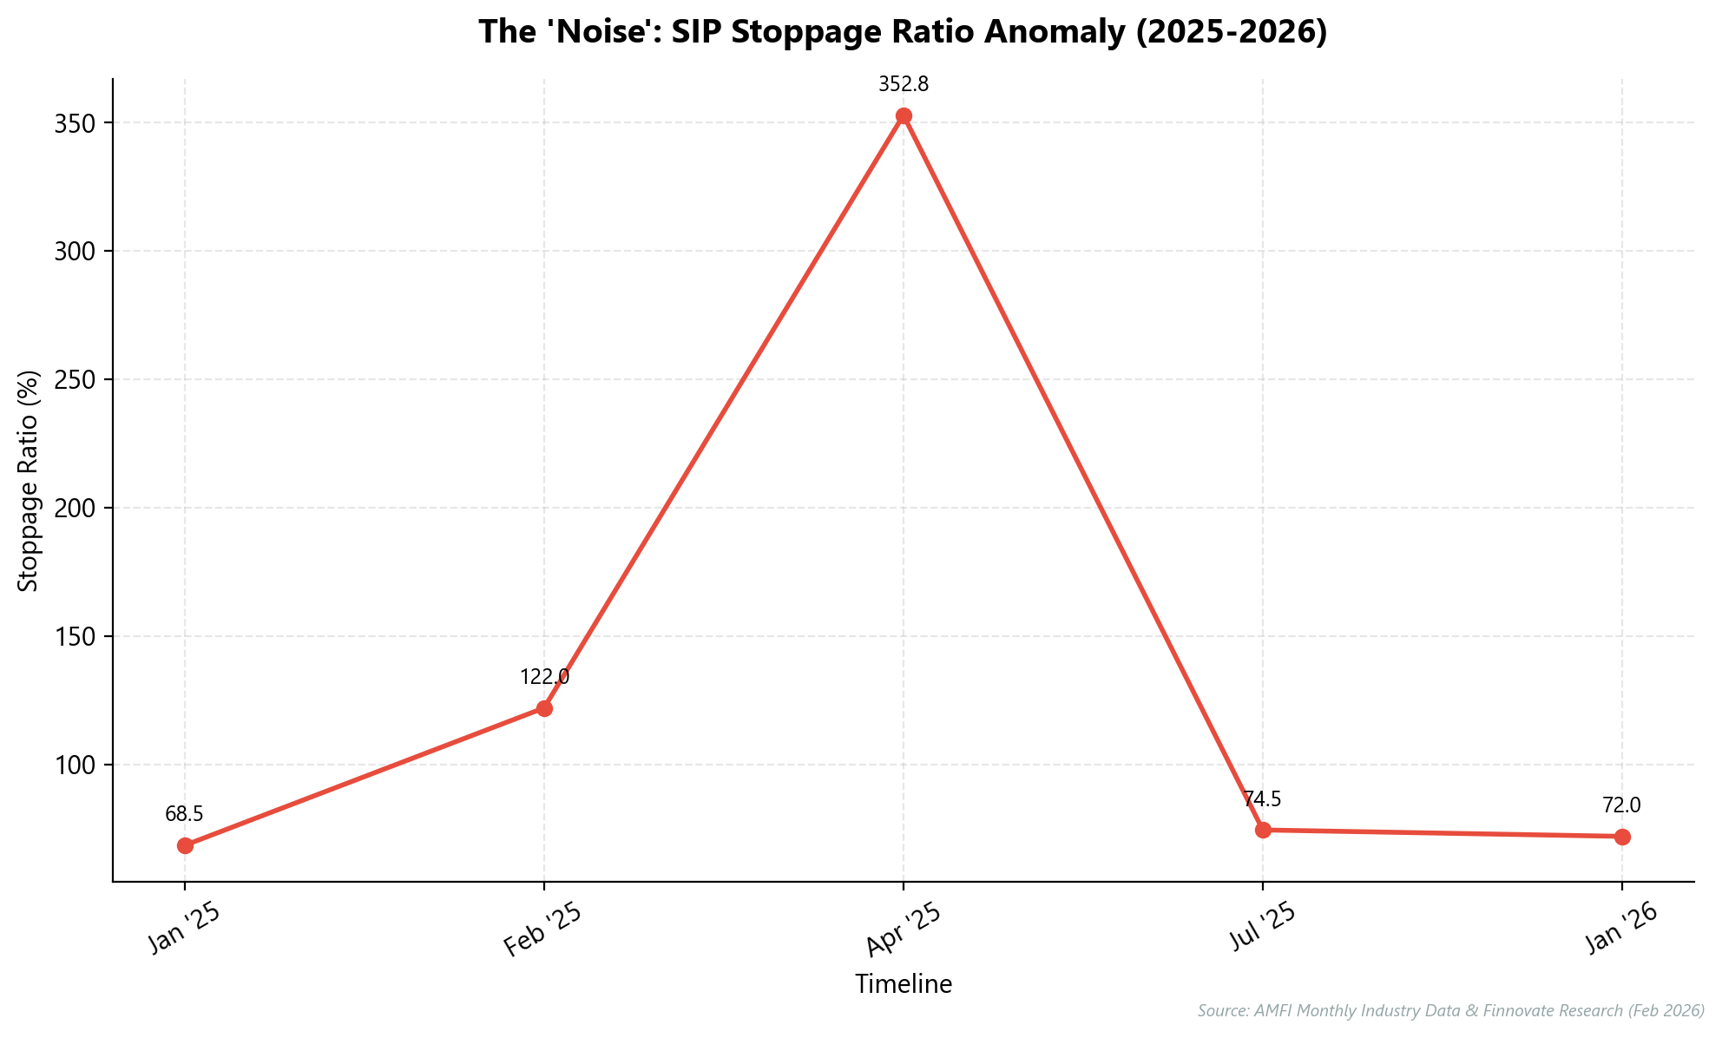
Distinguish Regulatory Noise From Structural Growth Signals
April 2025's 353% stoppage spike reflected dormant folio cleanup, not client exits.
1.43 crore non-operative folios were extinguished due to retrospective SEBI norms.
Normalized stoppage ratio stabilized at ~74.5% immediately post-cleanup.
Active SIP accounts grew to 9.92 crore by Jan 2026 despite "panic."
Strategic imperative: Ignore anomalies; infrastructure investment must match 17.2% inflow growth.
KEY INSIGHT: Recent data spikes were regulatory cleanups, not client exits; the long-term trend remains sticky.
6

Slide 7
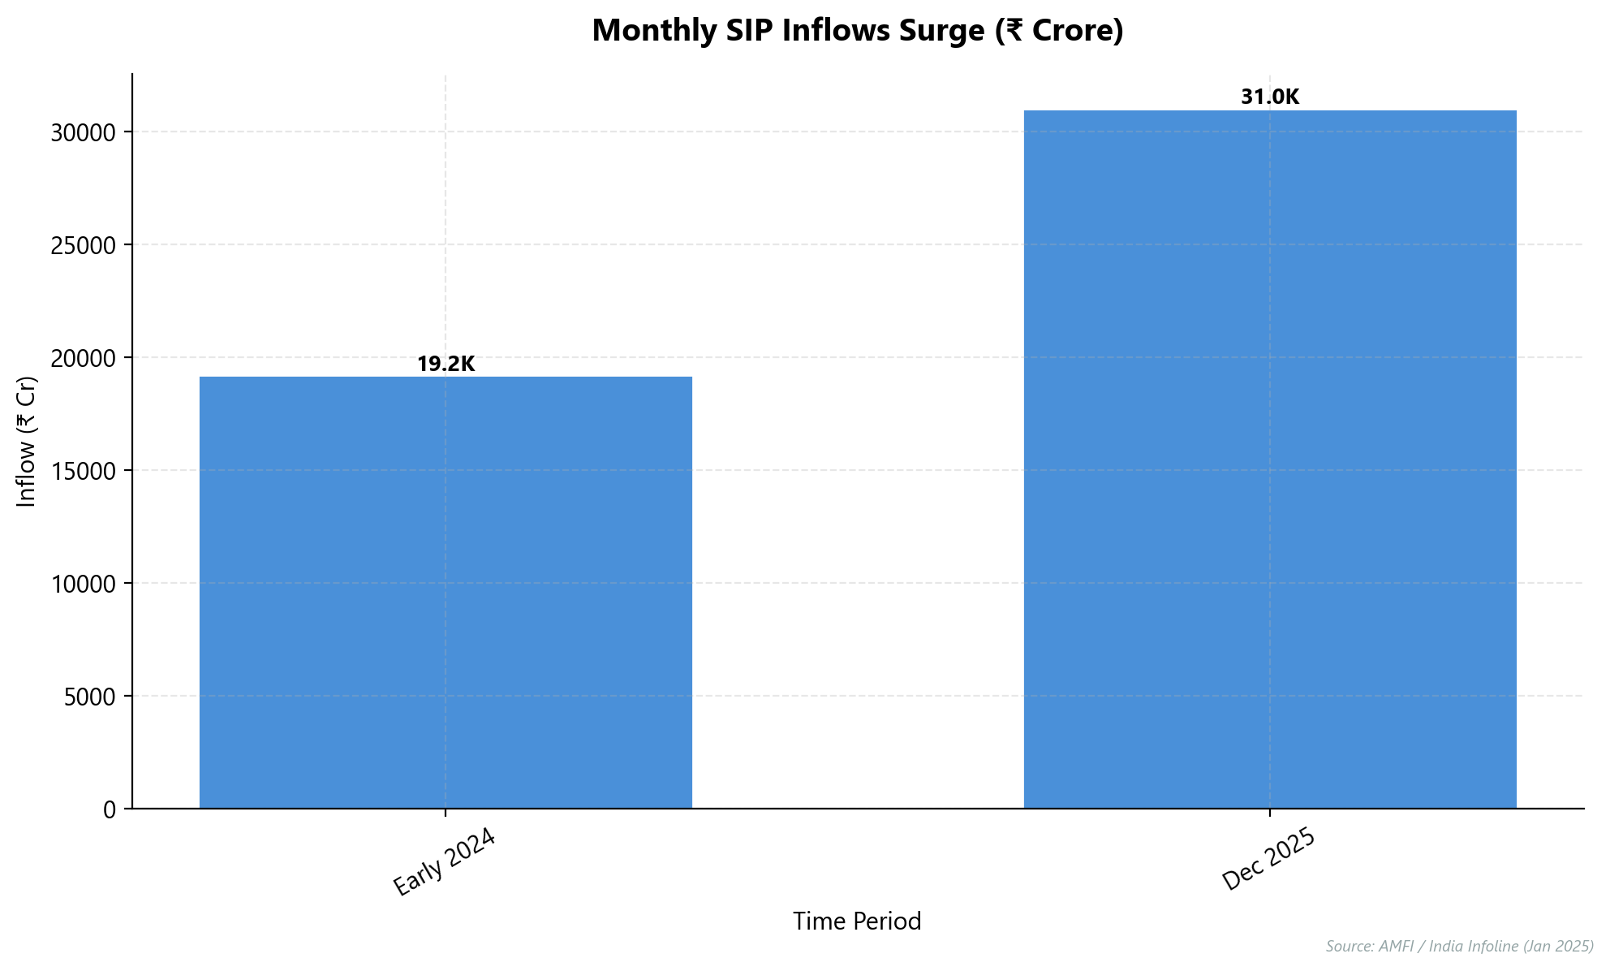
Centralize Data to Automate Mass Personalization
Automate onboarding and KYC to manage 22.50 crore folios efficiently.
Service B30 cities remotely, capturing 19% of industry assets without branches.
Manage 80% equity folio exposure using automated risk alerts and rebalancing.
Decouple profitability from ticket size by handling volume at near-zero cost.
KEY INSIGHT: A centralized database allows for 'Mass Personalization'—treating 10,000 clients like 10.
7

